Slide 1




NYC MEN TEACH
Building Pathways for Men of Color into the Teaching Profession

Slide 2

NYC Men Teach
A Powerful City-wide Commitment
In 2015, Mayor Bill de Blasio, as part of New York City's Young Men's Initiative, made a pledge to put an additional 1,000 men of color on course to become NYC public school teachers by 2018.
The power of a bold number like “1,000” resonated with the public, especially considering that most New Yorkers and Americans never had significant experience with a male teacher or male teacher of color in their K-12 academic years.
This numerical goal forged strong inter-agency collaboration unlike any other program in the nation between City Hall, The City University of New York and The New York City Department of Education.
NYCMT fueled our commitment to focus on new efforts to attract men of color

Slide 3
The Opportunity
New York City has a diverse student body, but our teaching force does not match our student body
Most teachers identify as female.
Teachers of color are underrepresented.

Slide 4
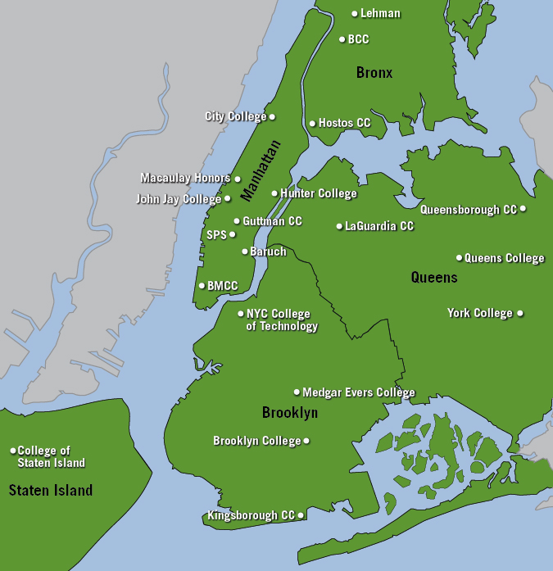
CUNY is the largest public, urban university in the US.
24 campuses across NYC
  Nine senior colleges and six community colleges offer Teacher Education programs
    Associate through doctoral degrees
  Robust community college to senior college pathway
275,000 students enrolled
  Majority of students identify as people of color
  Almost 80% of incoming freshmen are graduates of NYC DOE public schools
16,000+ teacher education students
  CUNY education programs prepare a strong cohort of teachers to the NYC DOE

Slide 5
Strong inter-agency collaboration
City Hall
City University
of New York
NYC Public Schools
NYC Public Schools
Young Men’s Initiative & Mayor’s Office for
Economic Opportunity
Funder
Policy driver
Evaluator
Office of Academic Affairs
Recruiter
Teacher preparation provider
Pre-service classroom work experience
Academic Advisement
Monthly Metro-Cards
Certification exam support
Teacher Recruitment & Quality (DHR)
Recruiter
Trainer
Employer
Division of Early Career Support and Induction
Induction
In-service support
Retention

Slide 6
Diversity and Inclusivity along the Pathway
With a diversified approach, we will encourage preservice teacher candidates who enter traditional education programs, by providing CRS-E professional development opportunities, as well as provide a higher-touch, cohort model for value-added interactions for our future pedagogues.
While we have seen some success with these shifts, the nature of taking a longer-term approach that will impact enrollment in traditional schools of education indicates that many of the strategies will not fully yield for 2-5 years.
Alternative Certification Programs
Long-term pathway programs Ed Rising- Ed Prep
Intentional
Marketing and Advertising
Recruitment of Traditional Graduates
Inclusive
Teacher Hiring Initiative
National Recruitment at HBCUs and Diversity events
Tackling Barriers to Entry
Families, parents, community leaders and student voice

Slide 7
Expanding Our Approach with Intentionality
By focusing our recruitment on
short-term strategies alone, we had to reimagine the scale of our alt-cert programs to identify
the level of diversity of the enrollees in traditional schools of education.
This pre-NYC Men Teach approach heavily relied on email, online advertising, and large-scale virtual events, with few opportunities to engage our audience with individual or small group support; there was a singular focus on those who were immediately ready to enter the classroom
Alternative Certification Programs
Recruitment from Traditional Schools of Education
70% of our alt-cert candidates identify as POC, whereas only ~30% of traditional recent graduate applicants identify as POC

Slide 8
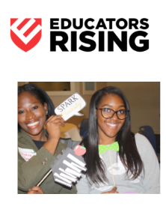
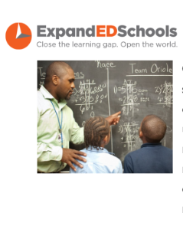
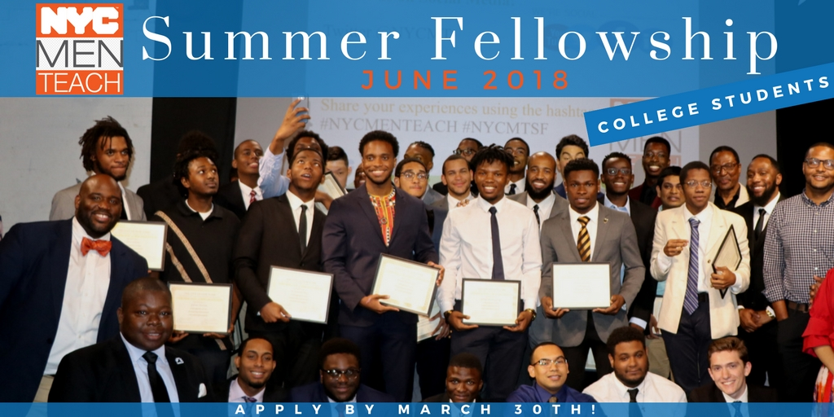
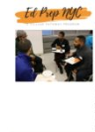
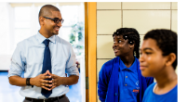
Long-term Teacher Pathway Programs
School-based Employees
Mentor
Ambassador support
Professional learning
Application support
Certification exam support:
  Financial Assistance
  Hiring Support
  Networking
  Case management
High School Students
Content development and accreditation
Program expansion and sustainability
Pathway expansion
Programming
College readiness
Re-imaging the school experience
College Students
Knowledge of daily school operations
Networking
Classroom teaching experience
Student engagement
Facilitated peer support
Stipend
Monthly MetroCard
Recruitment
Afterschool Tutors
Professional learning opportunities
Application support
Certification exam support:
  Financial assistance
  Hiring support
  Networking

Slide 9
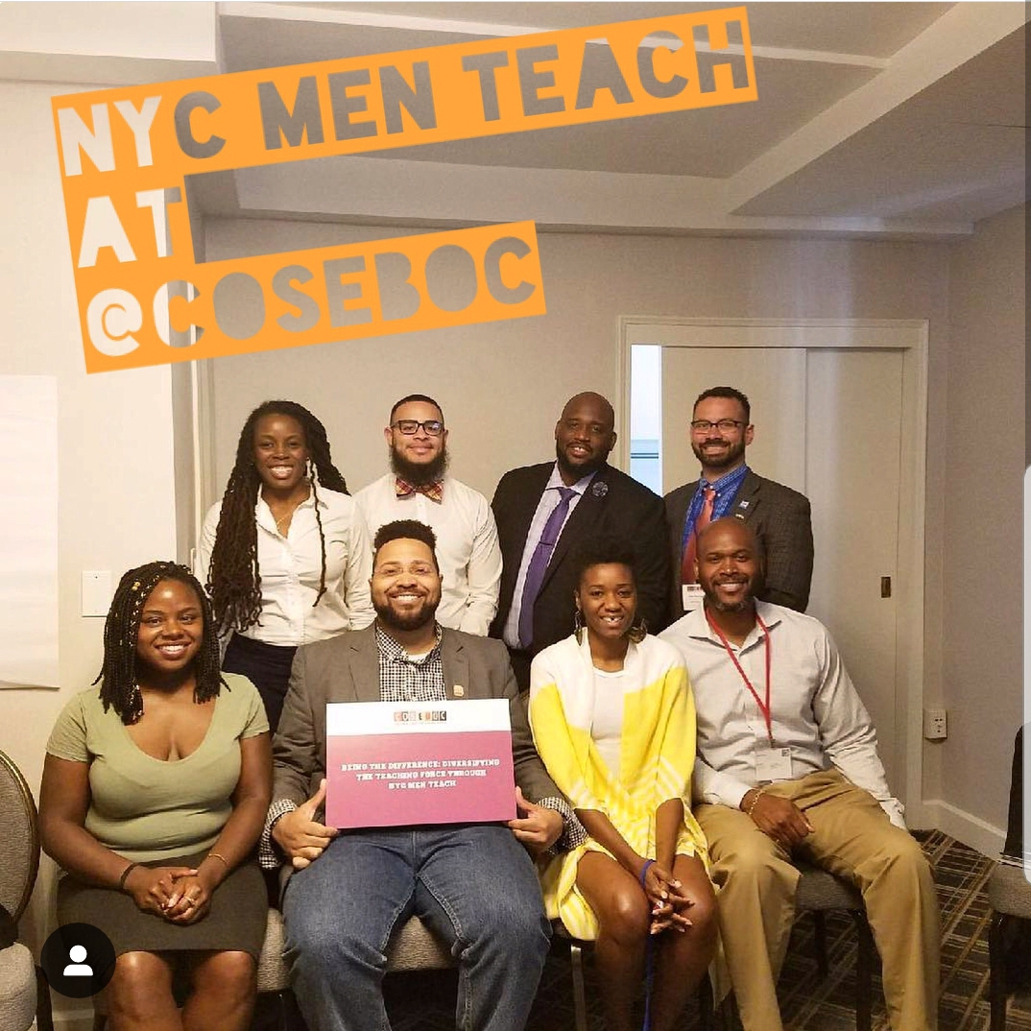
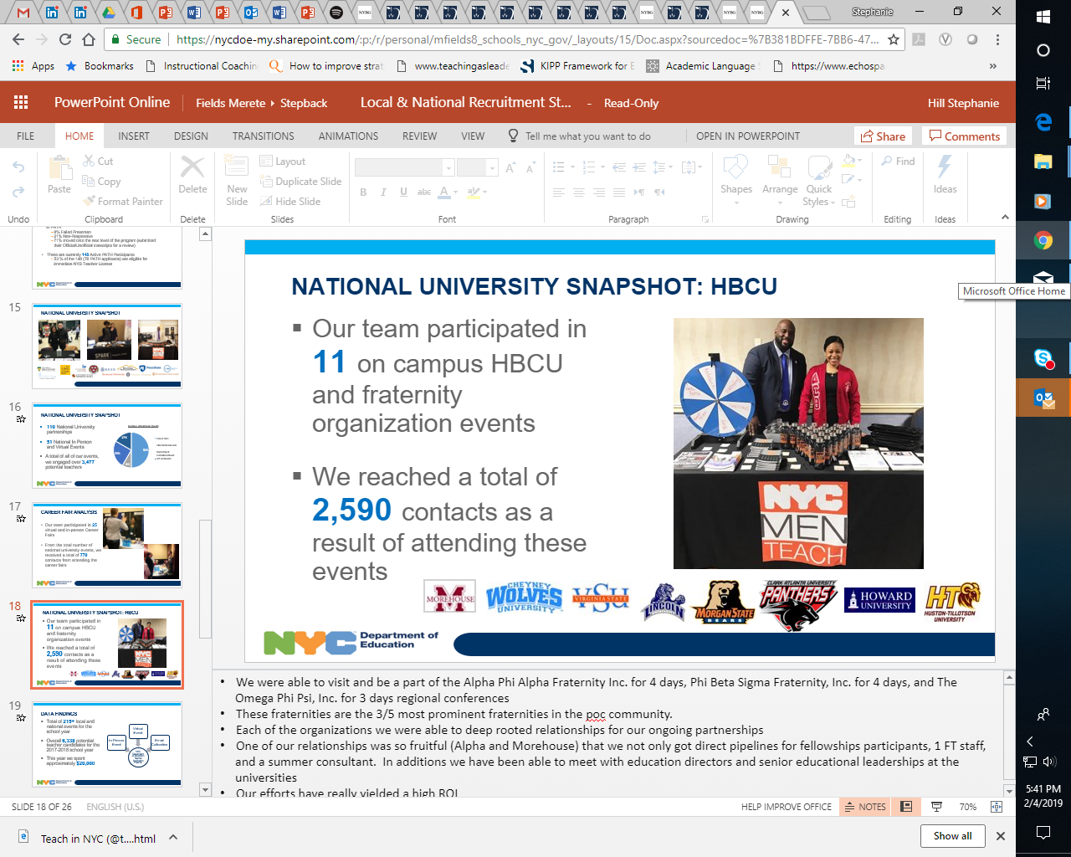
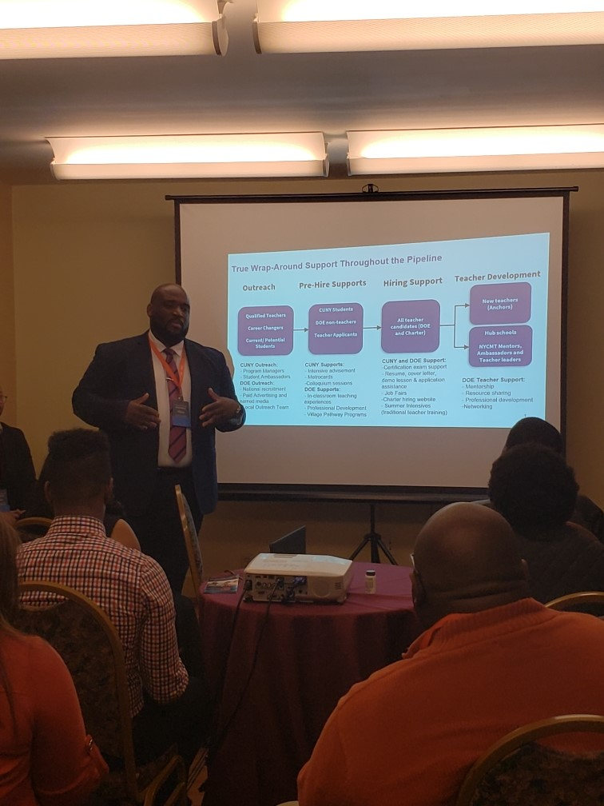
Increased Recruitment Reach
Team members have been invited to present our learnings at:
American Association for Employment in Education (AAEE)
Black Male Educators Alliance Conference (Philly Fellowship)
Coalition of Schools Educating Boys of Color (COSEBOC)
Teachers of Color Summit and Career Fair
SXSW EDU
Black Educators Rock Conference
Hispanic Education Summit
During the 2021-22 school year, the team attended 51 National (outside of NYC) in person and virtual events, yielding 3,477 new contacts
This included 11 events on campus HBCU and fraternity organization events

Slide 10
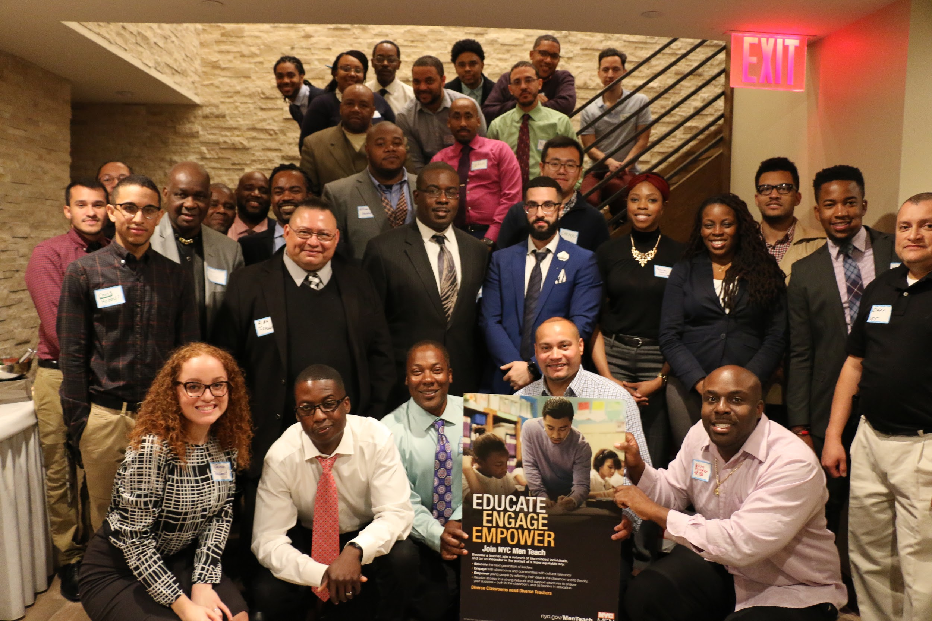
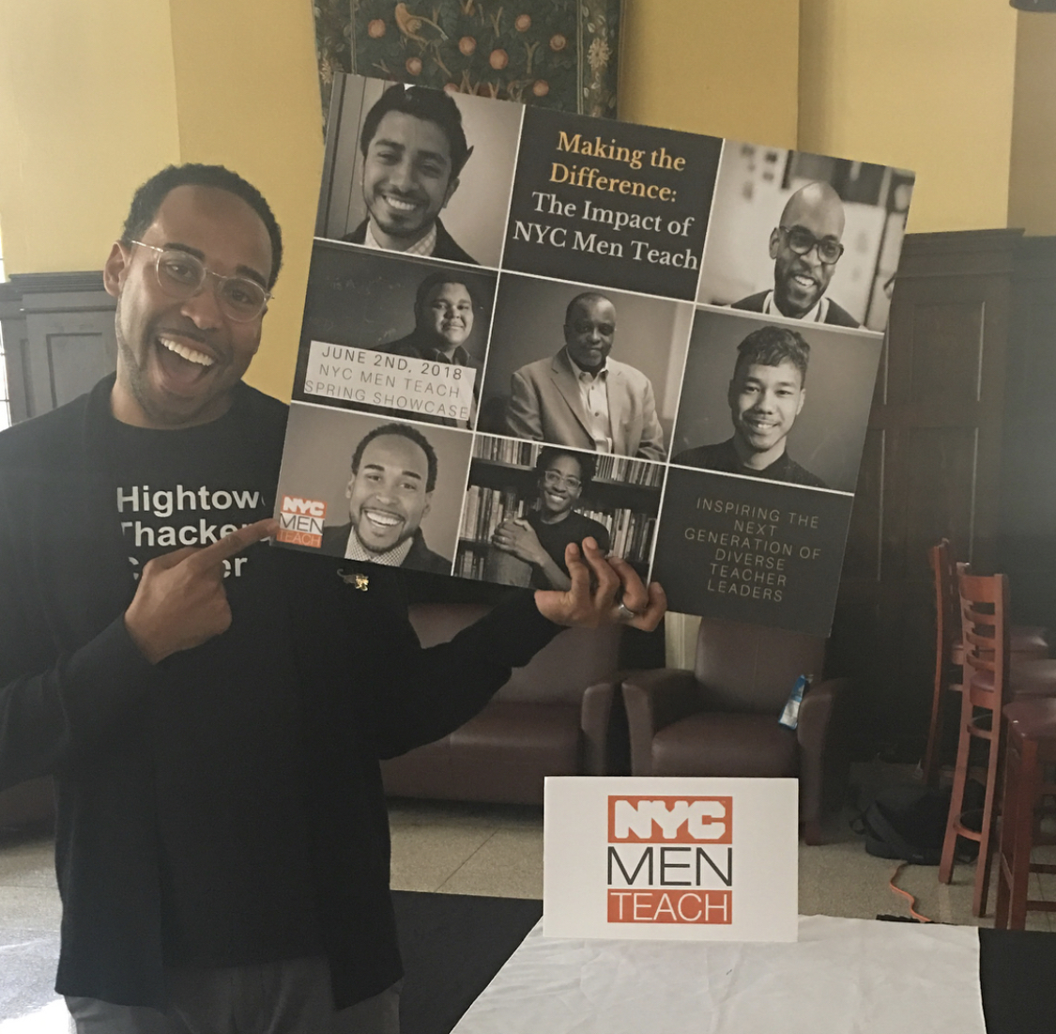
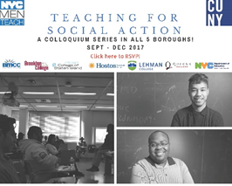
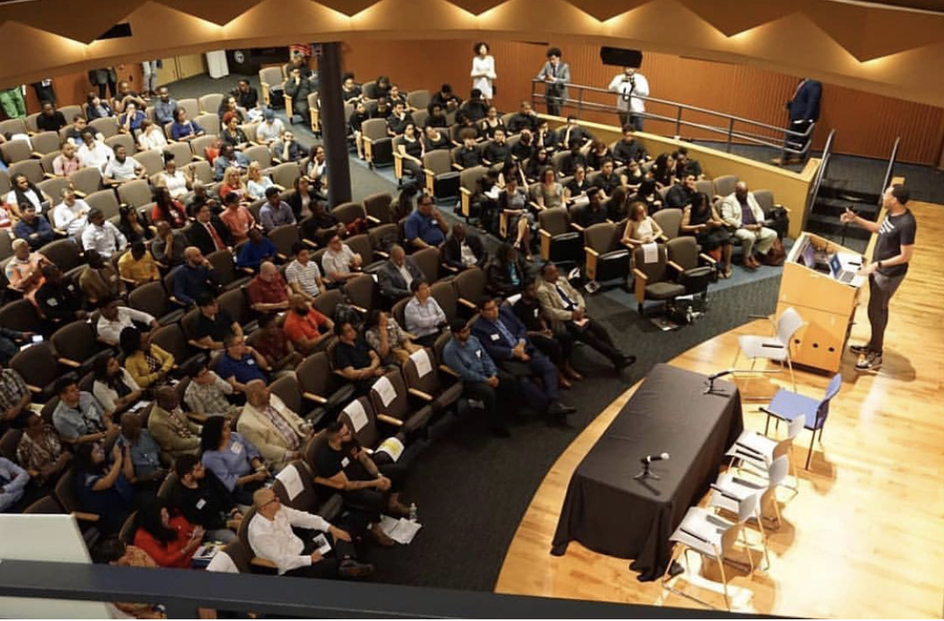
Community Events
Local, community based events create networking and cohort building opportunities, while supporting candidates to find their path to the classroom. Annually, the team hosts:
~20 Pathway Events – designed to help candidates identify the best teacher preparation program for their needs, hosted in The Bronx and Brooklyn
12 Monthly Third Thursday Events to bring together current teachers with aspiring teachers for network and community building
4-5 Partnership Events

Slide 11
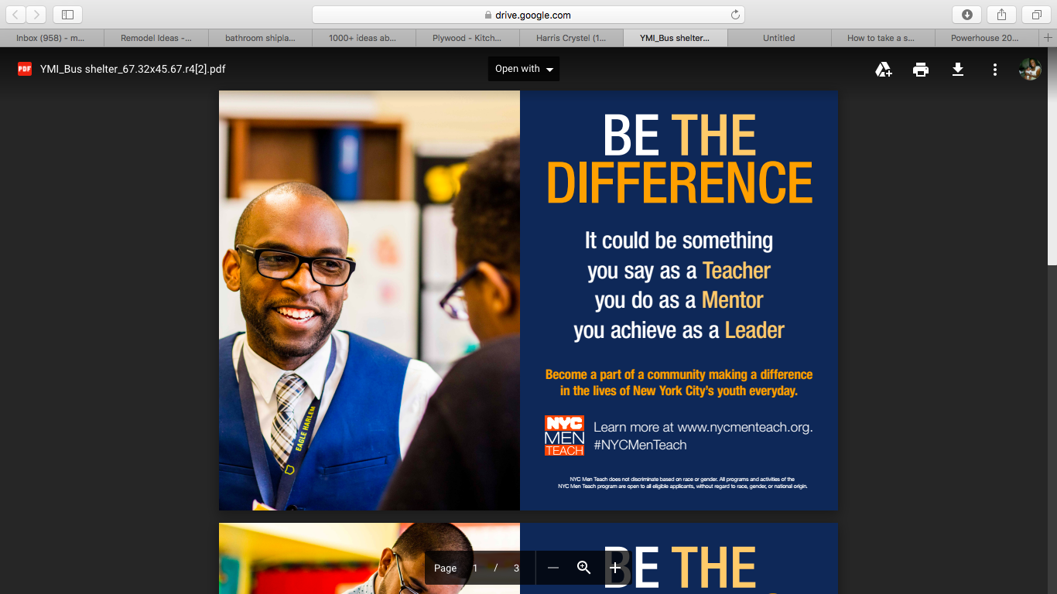

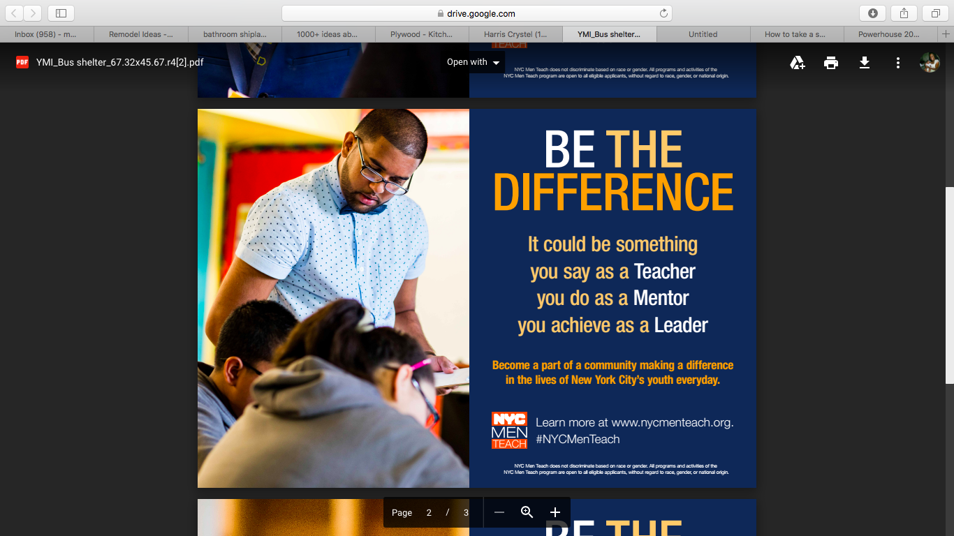
Advertising
  High quality content in targeted advertising helped make a clear invitation to men of color that we want them in the classroom

Slide 12

Building Relational Trust
At the core of these shifts is a commitment to being intentional in building long lasting, authentic and sustainable relationships.
Rather than adopting an exclusionary approach for the pool of preservice teacher, the focus is to meet candidates where they are and provide data-informed supports along their pathway to teaching.
This approach leads to empowering cohorts of committed candidates who will foster a willingness to engage and impact the learning of students and their families.

Slide 13
Program Status Updates
  The yearly average MOC teacher hires in NYC DOE has increased from 8% (in 2015) to 15% (in 2022)
  The yearly average POC teacher hires in NYC DOE has increased from 40% (in 2015) to 60% (in 2022)
  Alternative Certification pathways are particularly diverse: this year 77% of alternative certification hires are POC and 20% are MOC.
  MOC teacher retention remains strong – consistently, 88-90% of new MOC hires return to teach a second year, and 80% return to teach a third year
  85% of NYCMT program participants have reported they are likely to recommend the program to other aspiring teachers
  In an end of year survey, 85% of new teachers say that their mentor contributed to their effectiveness as a teacher​; over 68% of NYCMT Anchors have reported their NYC Men Teach Mentor as being important among the supports provided to them in early-career

Slide 14
Accomplishments
  2016 NYC Men Teach Launched
  647 MOC hires 2016
  725 MOC hires 2017
  702 MOC hires 2018
  473 MOC hires 2019
  258 MOC hires 2020
  815 MOC hires 2021. Highest number on record to date since we began this work in 2016.

Slide 15
Inclusive Teacher Hiring Initiative
  In this next phase of our system wide effort, NYC Men will build on the multi-prong momentum around equity and inclusion to focus on Inclusive Teacher Hiring.
  The DOE anticipates hiring over 15,000 new teaching staff over the next three years across 1,600 schools in support of 1.1 million students.
  Resources and guidance to support schools and hiring committees with Inclusive Teacher Hiring
  Peer Recruiters piloting resources in our highest needs schools this Spring
  Principals Conference Spring 22
  Deeper alignment with onboarding, especially lens of supports to onboarding Teachers of Color
  Resources/Guidance for retaining early career teachers, especially teachers of color
  Collaboration with TNTP, Eskolta and The Center for Black Educator Development

Slide 16
Inclusive Teacher Recruitment and Hiring Resources
Quick Reads
Inclusive Teacher Hiring Toolkit
Structured Interviewing Guide
Self-Paced Module
Onboarding
HR Roadmap
Hiring Manager Self-Assessment

Slide 17
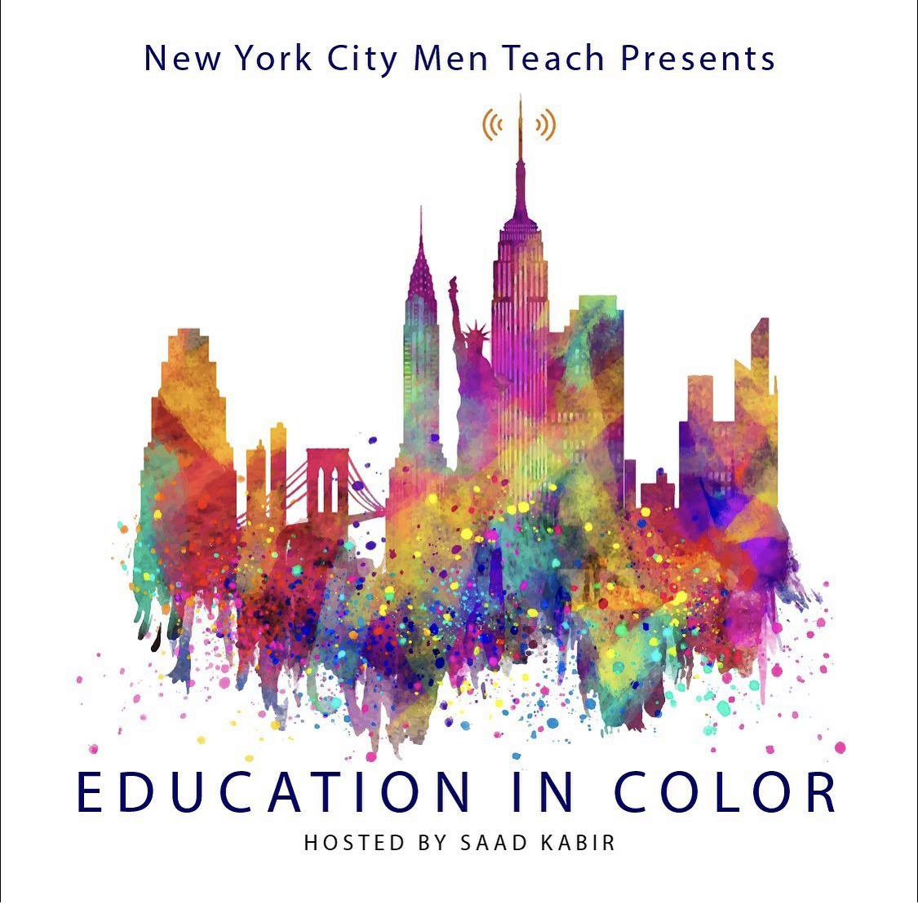
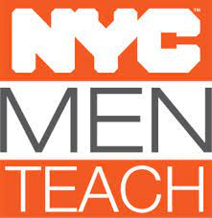
FUN FACT
  We have officially launched a NYCMT Podcast as a part of our diversity recruitment strategy to spread the word to both local and national teacher candidates.

Slide 18
Contact Information
  Chimere Stephens, Senior Director of Diversity Recruitment, NYC Public Schools
  Cstephens9@schools.nyc.gov

